Slide 1

Notes:
Hello everyone. Today, we’ll explore how Musinsa can successfully enter the Indian market using a data-driven business strategy.

Slide 2



Musinsa + India = Mundia
Notes:
In this project, we analyzed what a Korean fashion platform should consider when entering the Indian market. So, we created a hypothetical brand, MUNsinsa yuva where yuva means youth in hindi and analyzed data to make the best business strategy.

Slide 3
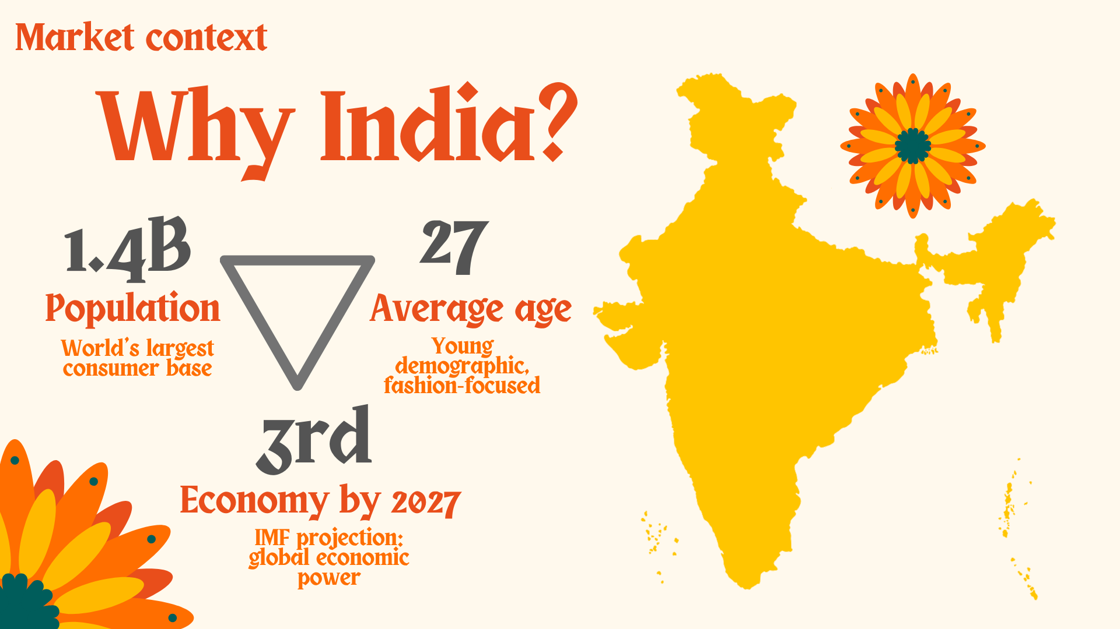
Notes:
Some people may wonder why we choose indian market
India is now one of the fastest-growing consumer markets, with the world’s largest population, which is about 1.4 billion and their average age is 27.
IMF projects that the india will be the third biggest economy by 2027. This makes India highly attractive for a youth-oriented fashion platform such as Musinsa.

Slide 4

Notes:
Musinsa recently announced their plans to expand into global market. Their key strategy in korean market has been Musinsa Fulfillment Service (MFS), which offers free shipping and same-day dispatch, similar to Amazon’s FBA. That means, the logistics and inventory management has been the key important issue for the brands.

Slide 5
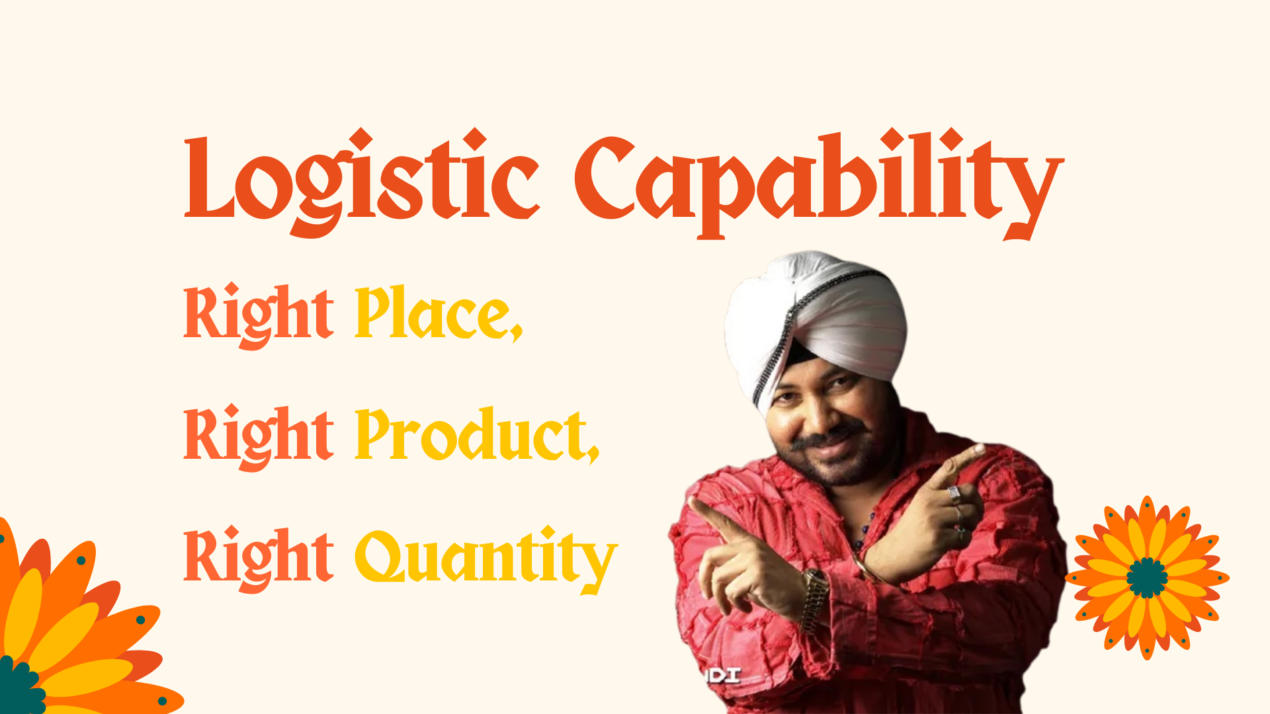
Notes:
So companies need to focus on the right product, and the right quantity in the right place.---> 2

Slide 6
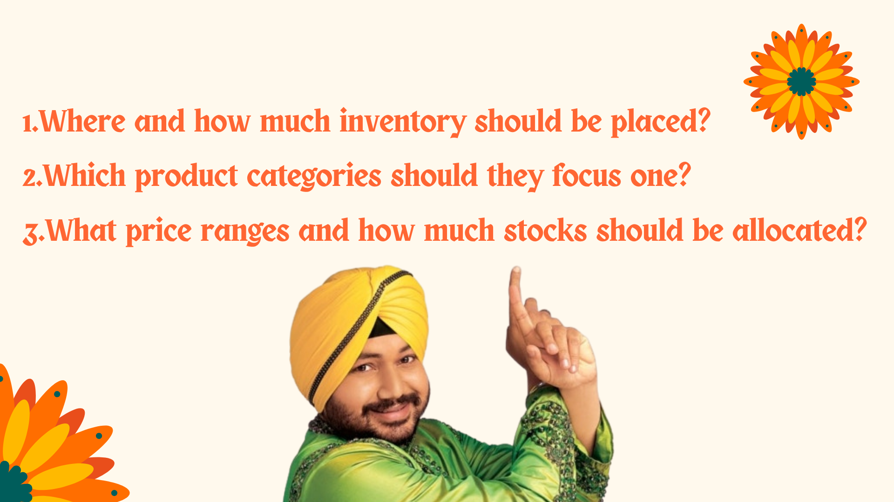
Notes:
Based on this, our first research question is: Where and how much inventory should be placed?
This is the exactly same question as which region should brands enter first and dominate?
Second research question is: Which product categories should they focus one? —>4
And finally, we ask: What price ranges and how much stocks should be allocated?--->5

Slide 7
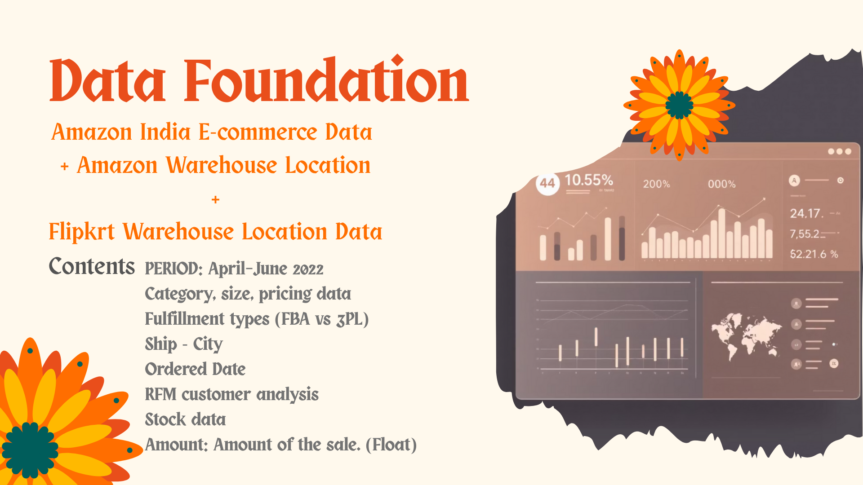
Notes:
To answer those research questions, we used Amazon India e-commerce data during April to June 2022 from kaggle , which includes categories for clothes, size, price, fulfillment type, region, and order statu, amount of sales.129,000 order data were included in this dataset.
We also used Amazon warehouse location data and flipkart warehouse location data separated from the kaggle to delve deeper into the location question.

Slide 8

Notes:
In the clothing categories, there were 9 types of clothes. you might see the unfamiliar names such as kurta, saree, dupatta which are the indian traditional clothing.

Slide 9
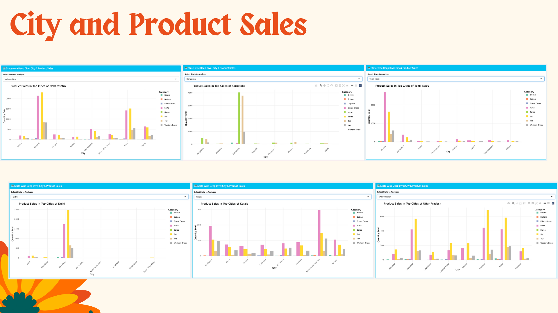
Clothing Categories (옷 사진 대체 필요
Notes:
This dashboard shows product sales by category across major Indian states. Each chart represents one state, and the bars compare sales across its top cities.
What stands out first is that sales are highly concentrated in just a few cities. In states like Delhi, Karnataka, and Tamil Nadu, one or two cities account for most of the sales. We also see that preferences differ by region. In some states, kurtas sell the most, while in others, sets perform better.
so the key takeaway is that we should prioritize specific high-potential cities first, and then focus on the right cities and products within them.

Slide 10
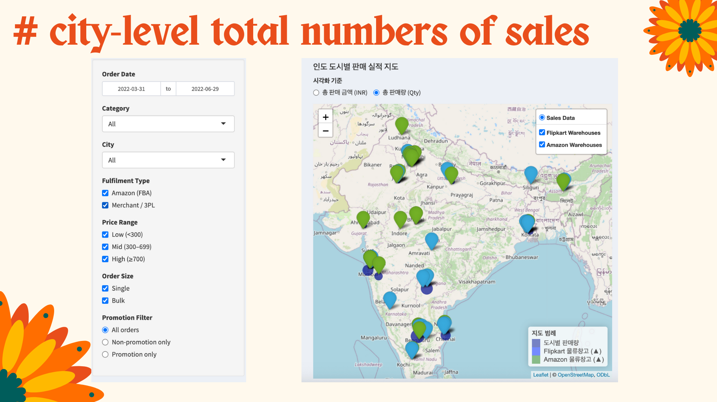
Notes:
We further look into the logistics infrastructure.
Here, we can see the warehouse locations of Amazon and Flipkart.
These locations are important because they were chosen to serve the maximum number of markets at the lowest possible cost.
users can choose whether or not to include these warehouses,
and see how sales levels differ across cities. These warehouse locations can be a useful indicator in logistics
because they signal areas where sales are already strong and where a large volume of transactions is taking place. In other words, brands can know regions that need a lot of f inventory.

Slide 11
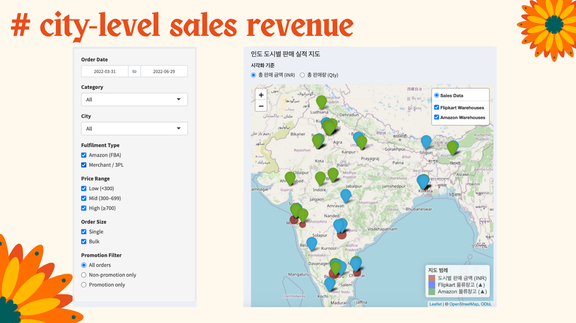
Notes:
Here, we visualize city-level sales revenue on the map

Slide 12
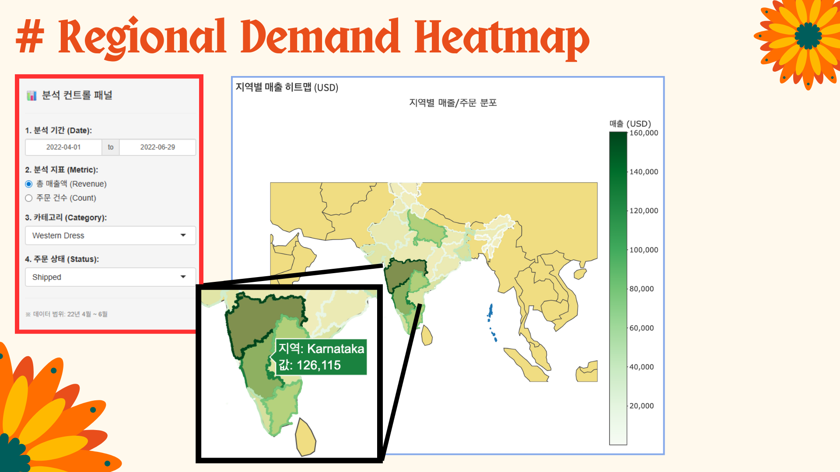
Notes:
We can see how the sales and revenue differ by region based on categories of clothing, and shipping state. Users can choose the date and the outcome variable which can be either revenue and total sales, depending on the categories of clothes, and shipping status.

Slide 13
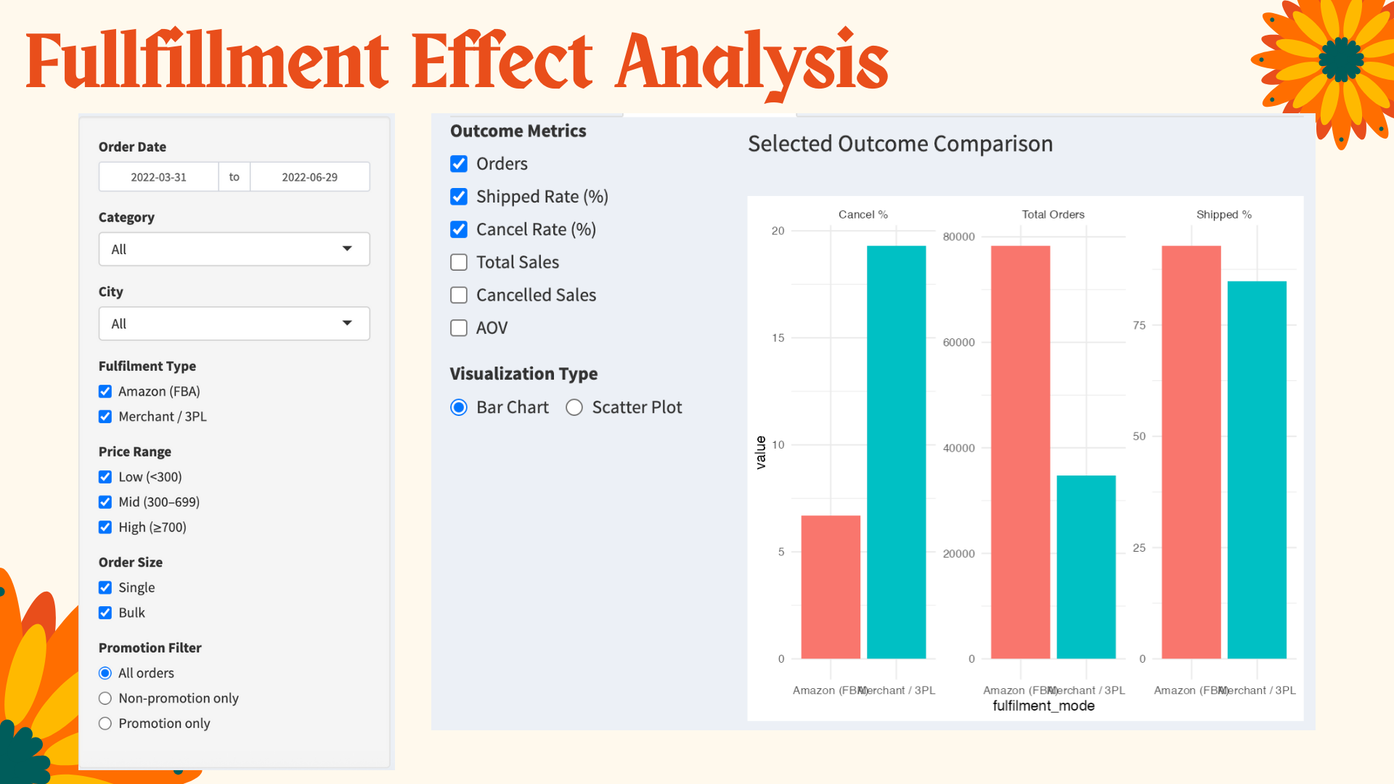
Notes:
We compared Amazon FBA and Merchant 3PL across key performance metrics.
“With Amazon FBA, Amazon stores and ships the products and handles customer service,
while Merchant 3PL relies on external logistics partners.
As a result, FBA offers faster and more reliable delivery, whereas 3PL is low cost but takes more times for delivery.
he cancellation rate, we see a clear difference. FBA has a cancellation rate of around 7%, while Merchant 3PL is much higher, at around 21%.
On the top right, cancelled sales value, we can also see that 3PL loses more revenue due to cancellations, and had lower total sales overall.
Moving to the bottom row, FBA processes almost twice as many orders as Merchant 3PL, and also shows a higher shipped rate, close to 100%, compared to around 90% for 3PL.
Finally, looking at total sales, Amazon FBA generates substantially higher revenue than Merchant 3PL.
Overall, while Average order value is similar, FBA outperforms 3PL in scale, reliability, and revenue impact.

Slide 14
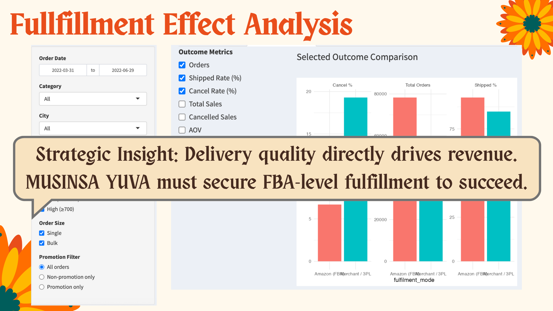

Slide 15
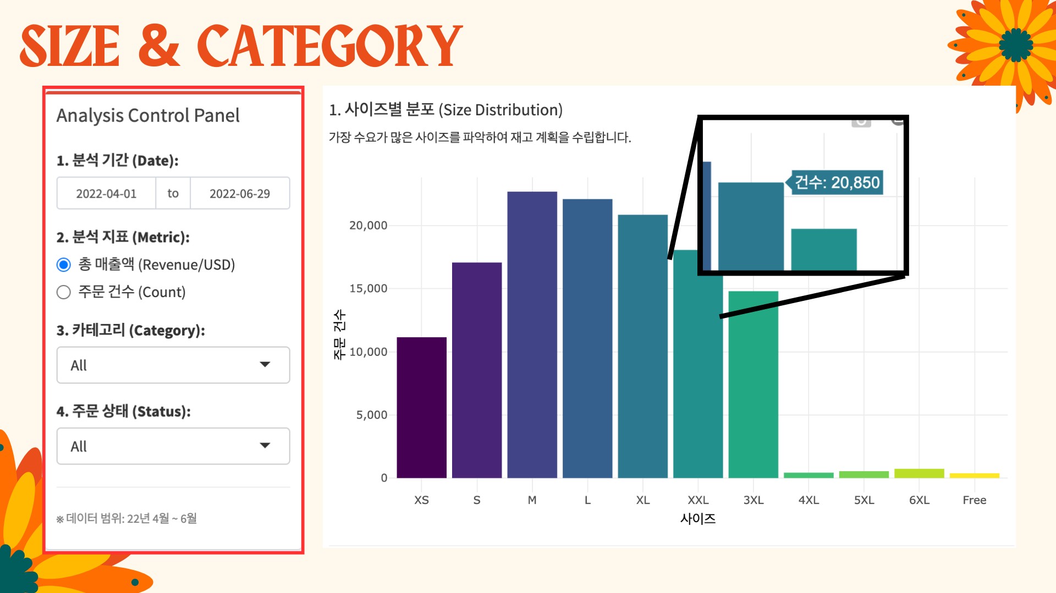
Notes:
⭐ 4. Size & Category Insights (1.5 min)
“Size demand concentrates on S, M, L, and XL and we can see the distribution of size after filtering by category of clothes and the order status and the order date in shiny app.

Slide 16
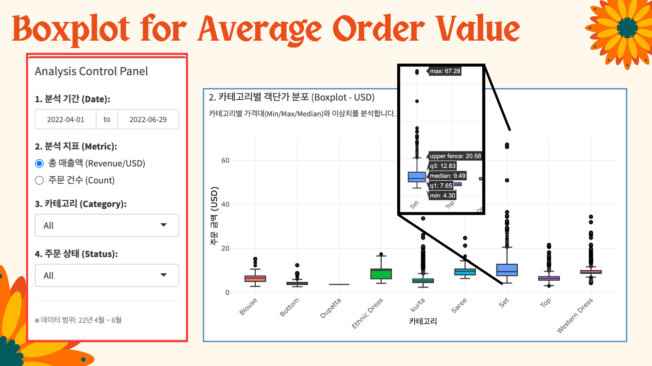
Notes:
Here, we can see how the price for the product is different depending on the categories Basics like bottoms are more tightly priced.
Sets and western dresses, however, show a much wider spread.

Slide 17
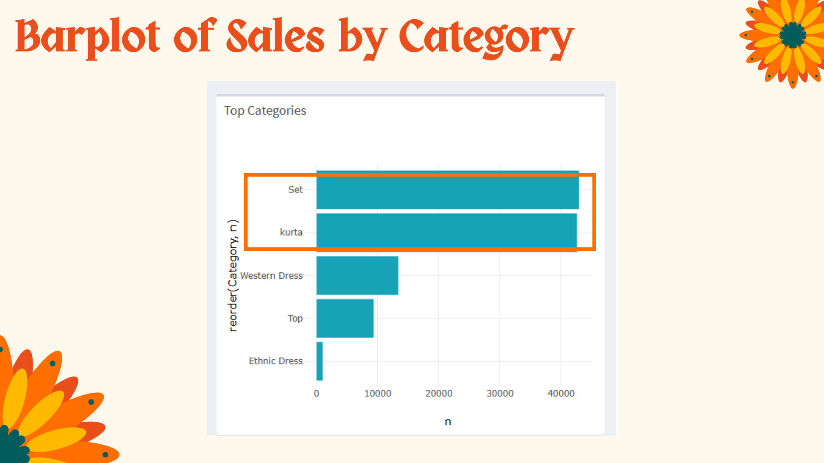
Notes:
Here, we’re looking at the top-selling categories. Sets and kurtas clearly dominate in terms of sales volume. They account for a much larger share compared to other categories.
Western dresses and tops follow, while ethnic dresses contribute relatively little to overall sales.

Slide 18
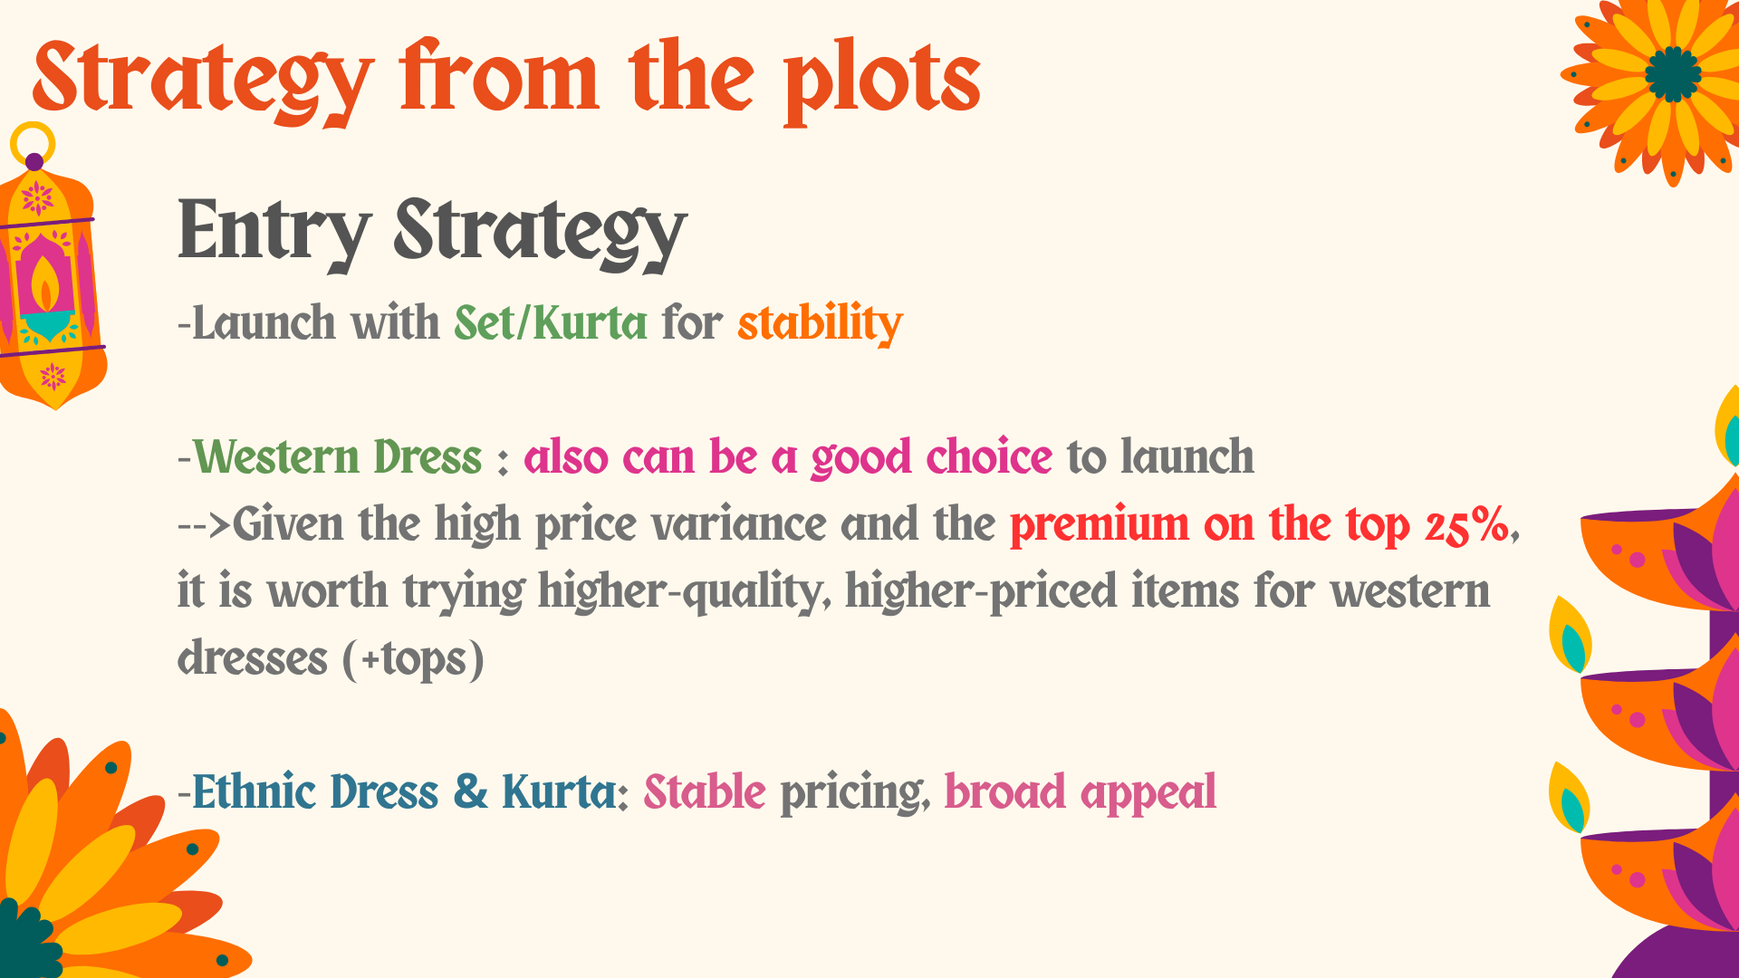

Slide 19
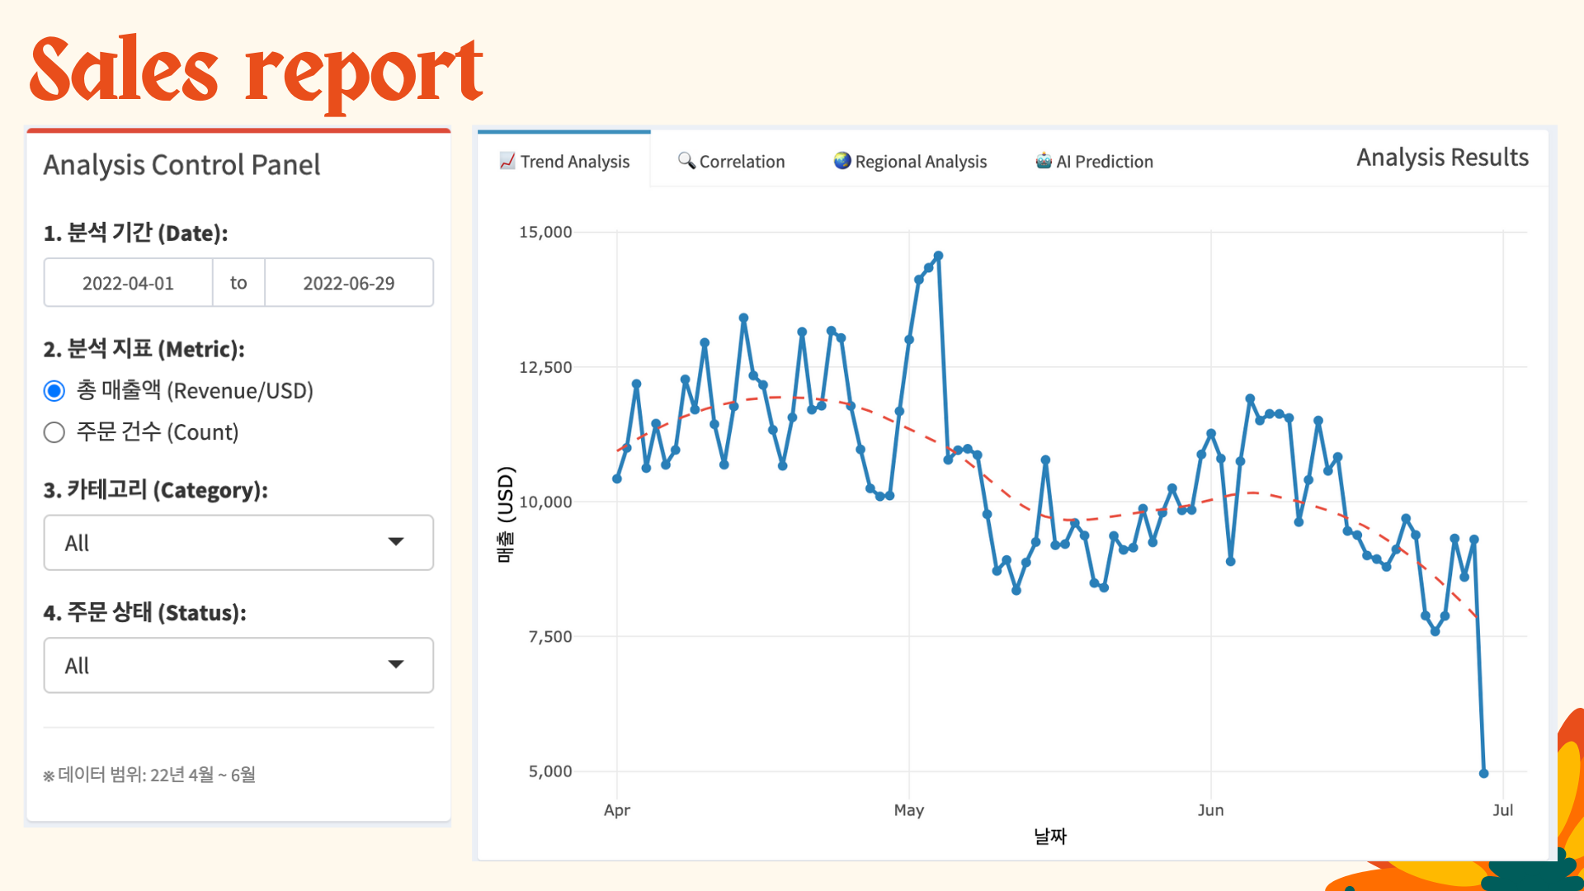
Notes:
On this Shiny dashboard, users can interactively explore daily sales trends.
In this Shiny app, users can select the time period, metric, category, and order status. The chart then updates to show daily trends, making it easy to see changes over time.

Slide 20
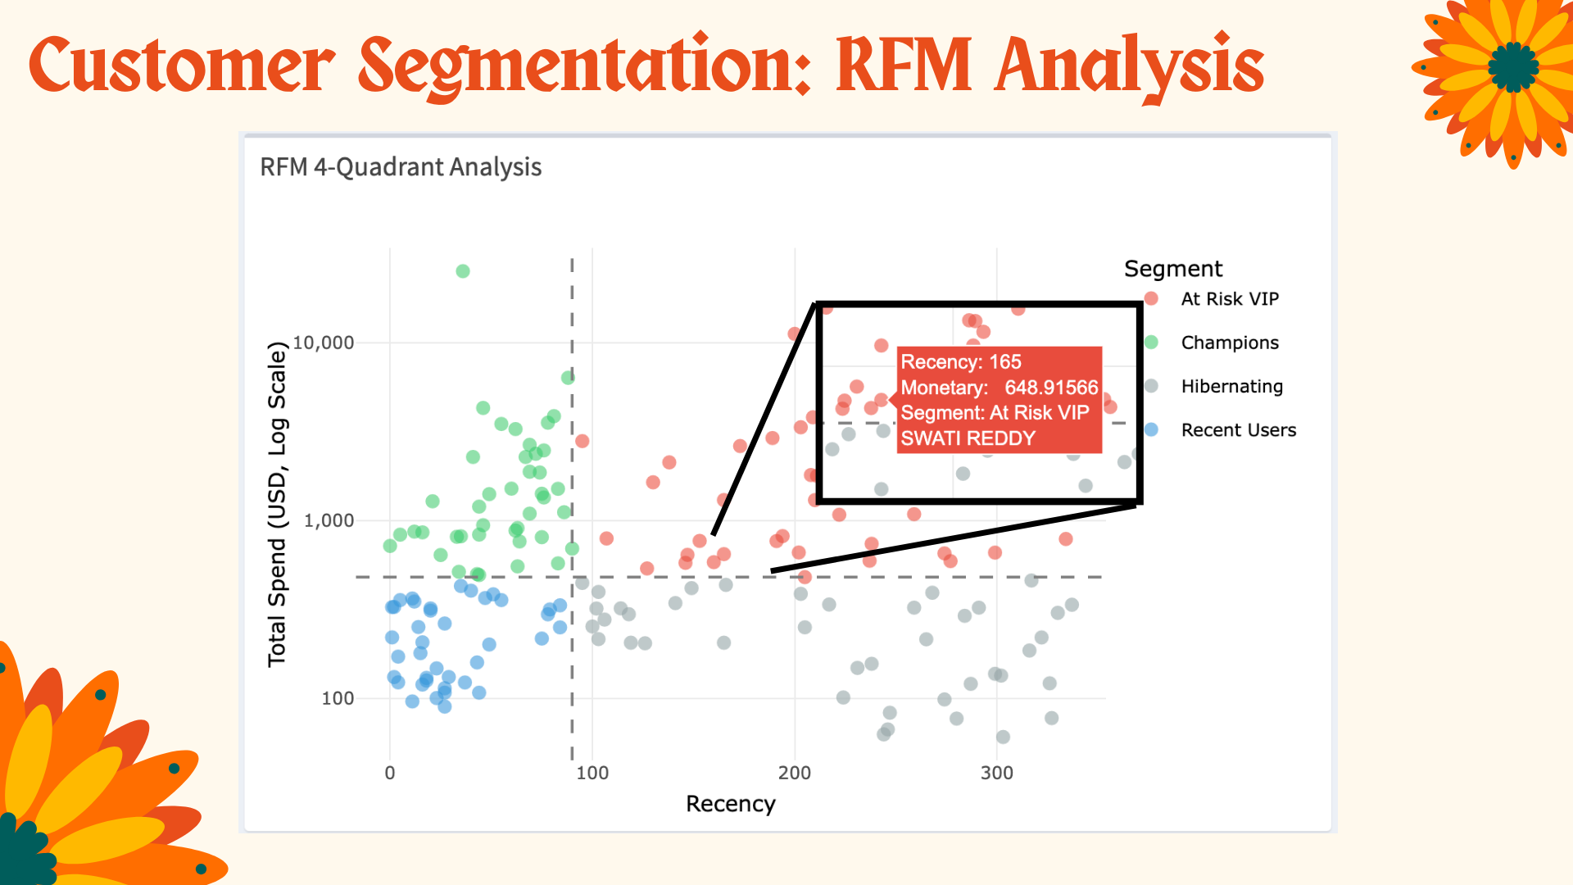
Notes:
We define the quadrant thresholds using median splits. The median recency is 90 days, and the median total spend is about 440 usd.
Based on these thresholds, we classify customers into four segments.
Champions are recent visitors who have high spending. At-risk VIPs are high spenders who haven’t purchased recently. Recent users are active but lower-spending customers. And hibernating users are neither recent nor high value.

Slide 21
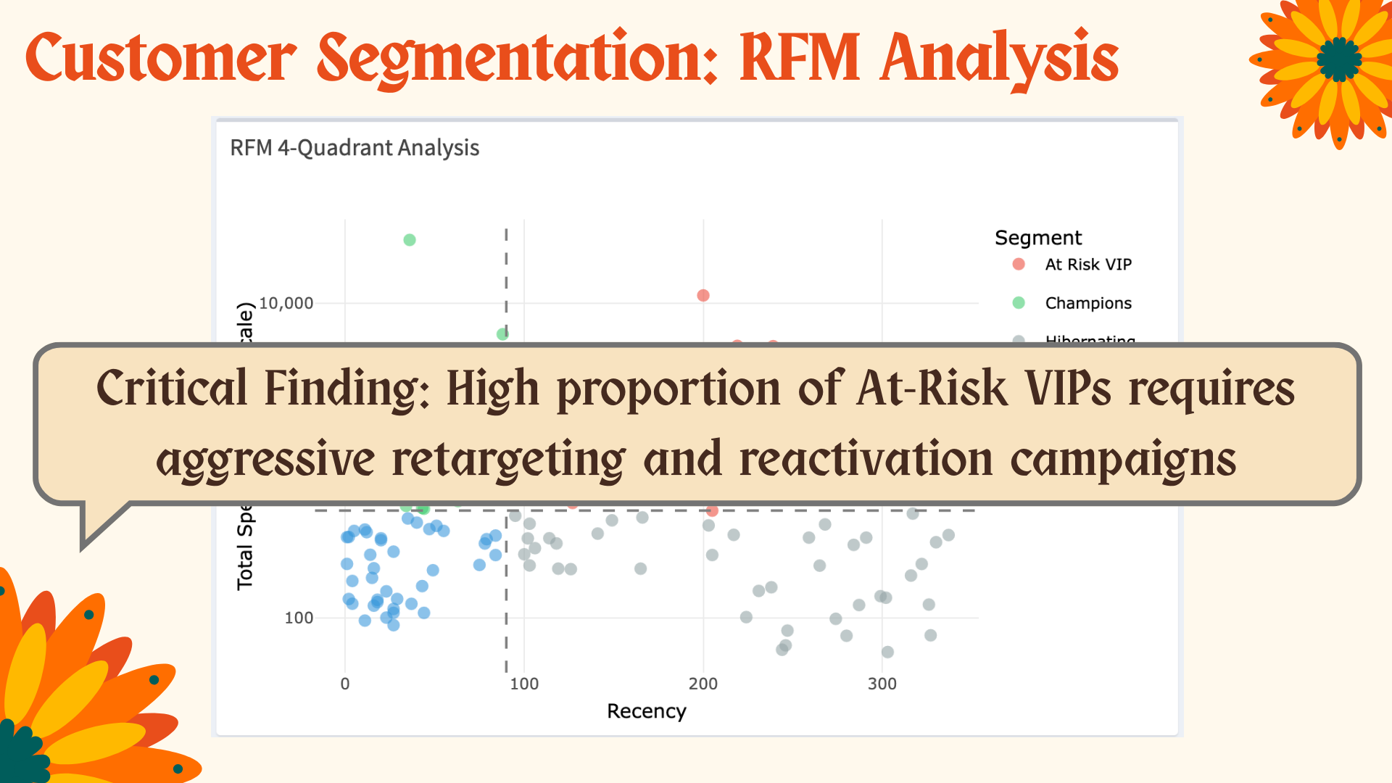

Slide 22
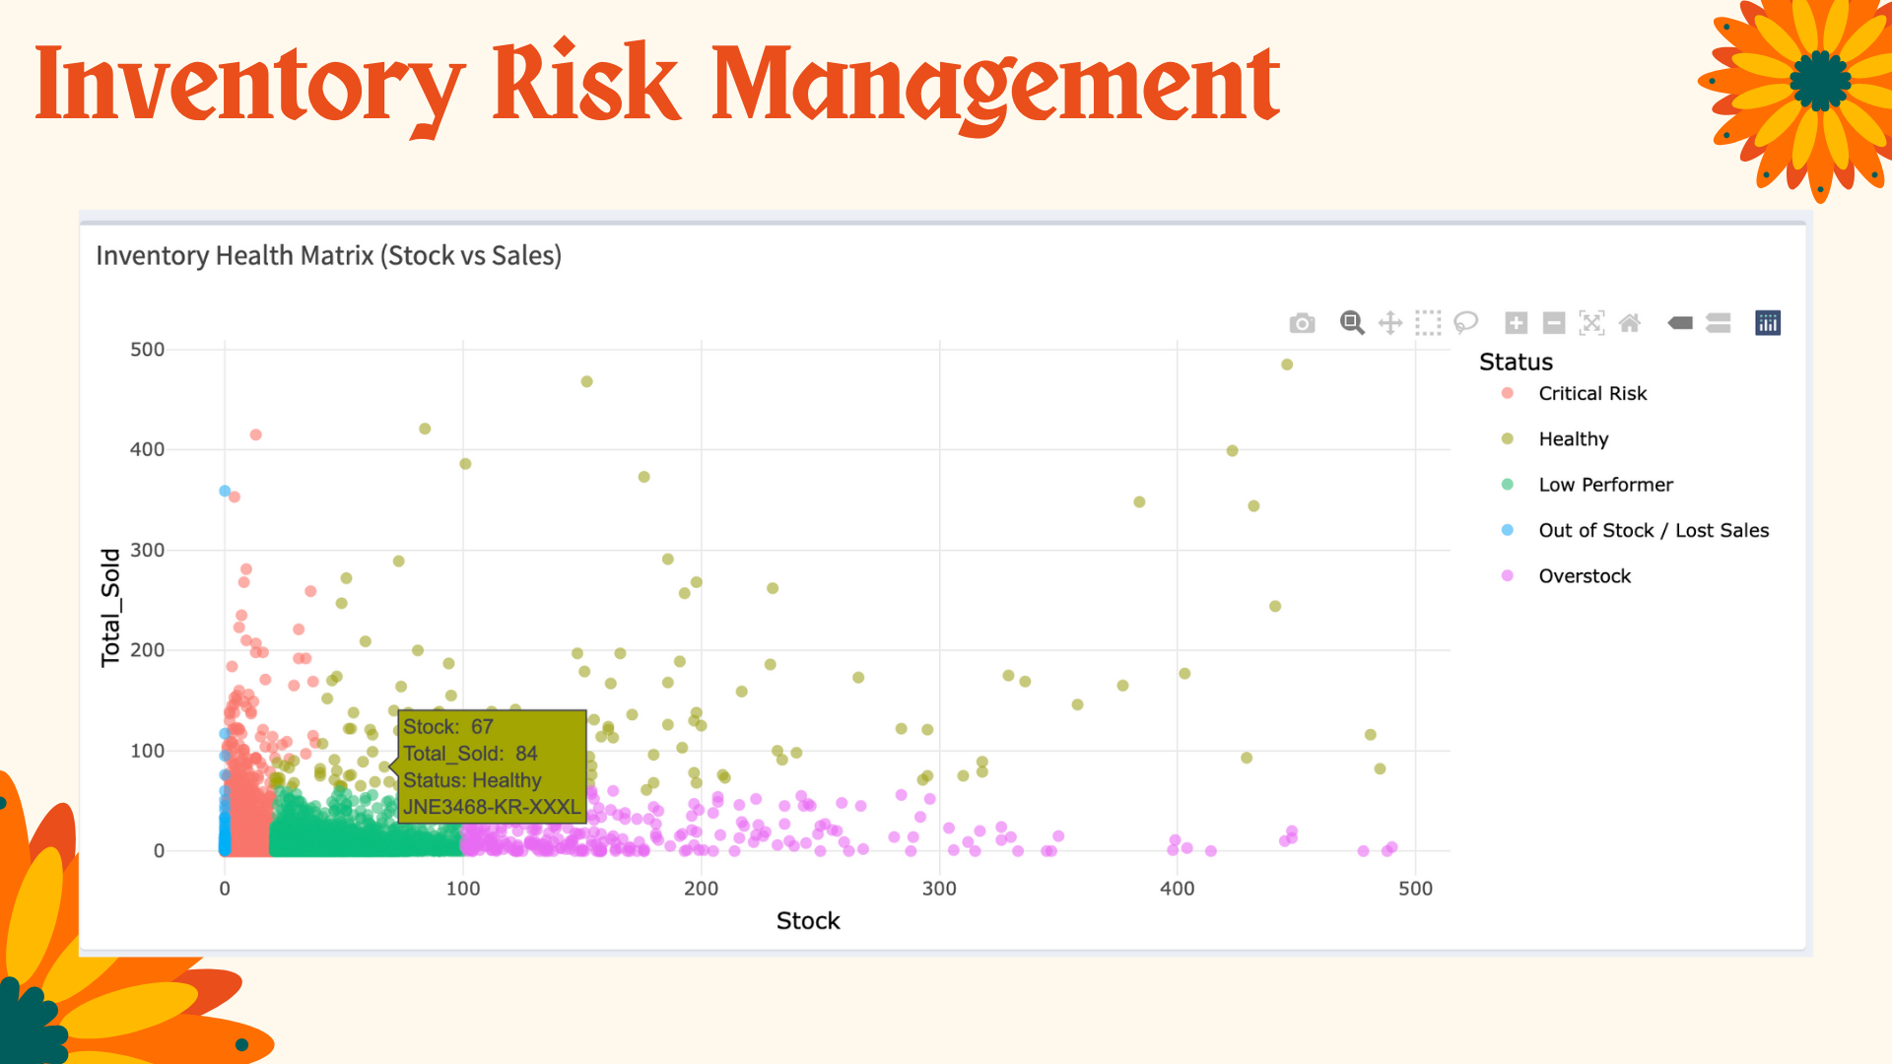
Inventory Bridge Analysis
30-Day Sales Forecast (ARIMA)
Daily average: 410K INR
30-day total: 12.3M INR
Upper confidence: 13.7M INR
Maintain 20%+ safety buffer above average forecast due to high volatility
Notes:
“This chart is an Inventory Health Matrix, showing the relationship between stock levels and total sales.”
The x axis is the numbers of stocks and the y axis show the total sales on the y axis. Products are classified into Healthy, Overstock, Low Performer, Critical Risk, and Out of Stock, so we can clearly see product performance by inventory status.

Slide 23
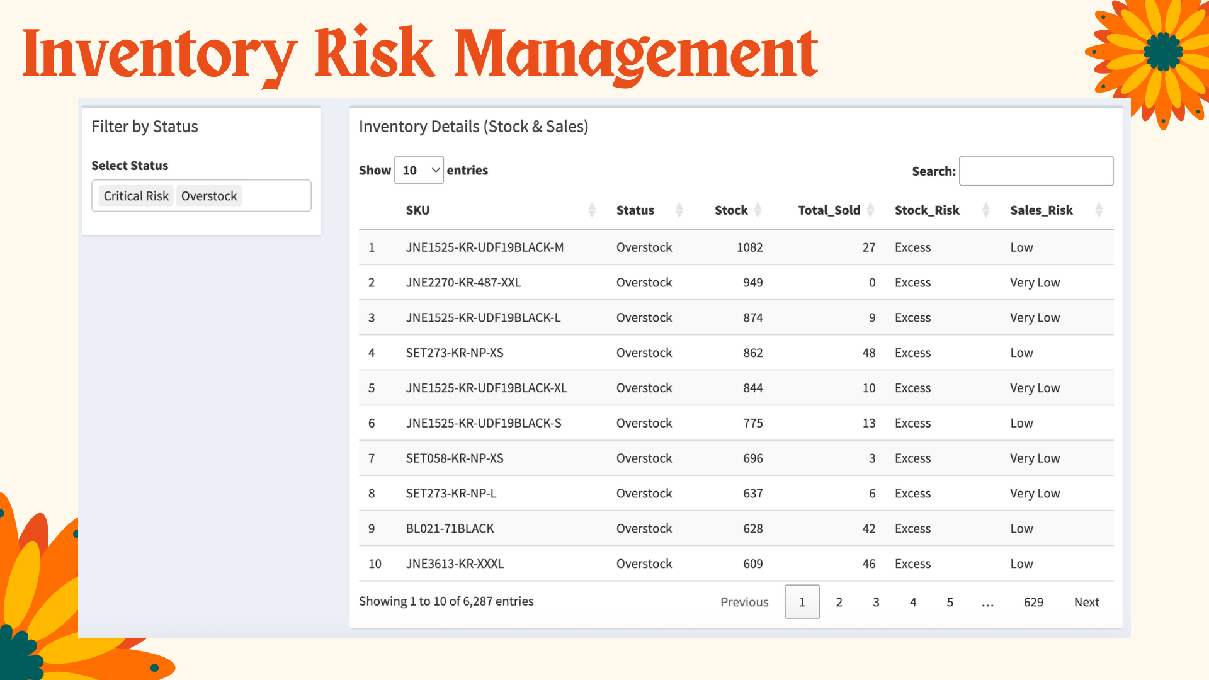

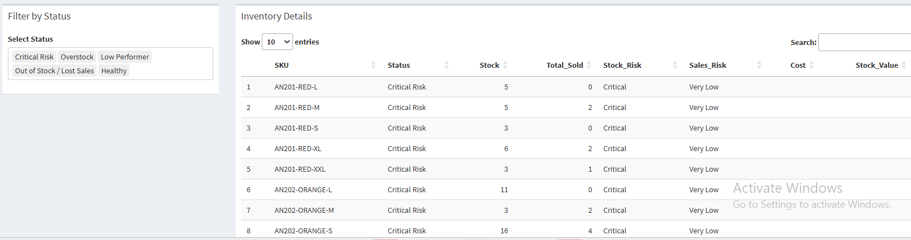
Inventory Risk Management
Inventory Bridge Analysis
Critical Risk: Low stock + high sales = stockout danger
Overstock: Excess inventory = cost inefficiency
Healthy: Balanced inventory levels
30-Day Sales Forecast (ARIMA)
Daily average: 410K INR
30-day total: 12.3M INR
Upper confidence: 13.7M INR
Notes:
sers can filter these statuses directly and
can see how many times they were sold and how many stocks are available by product SKU. We can also see stock status such as critical risk or healthy

Slide 24
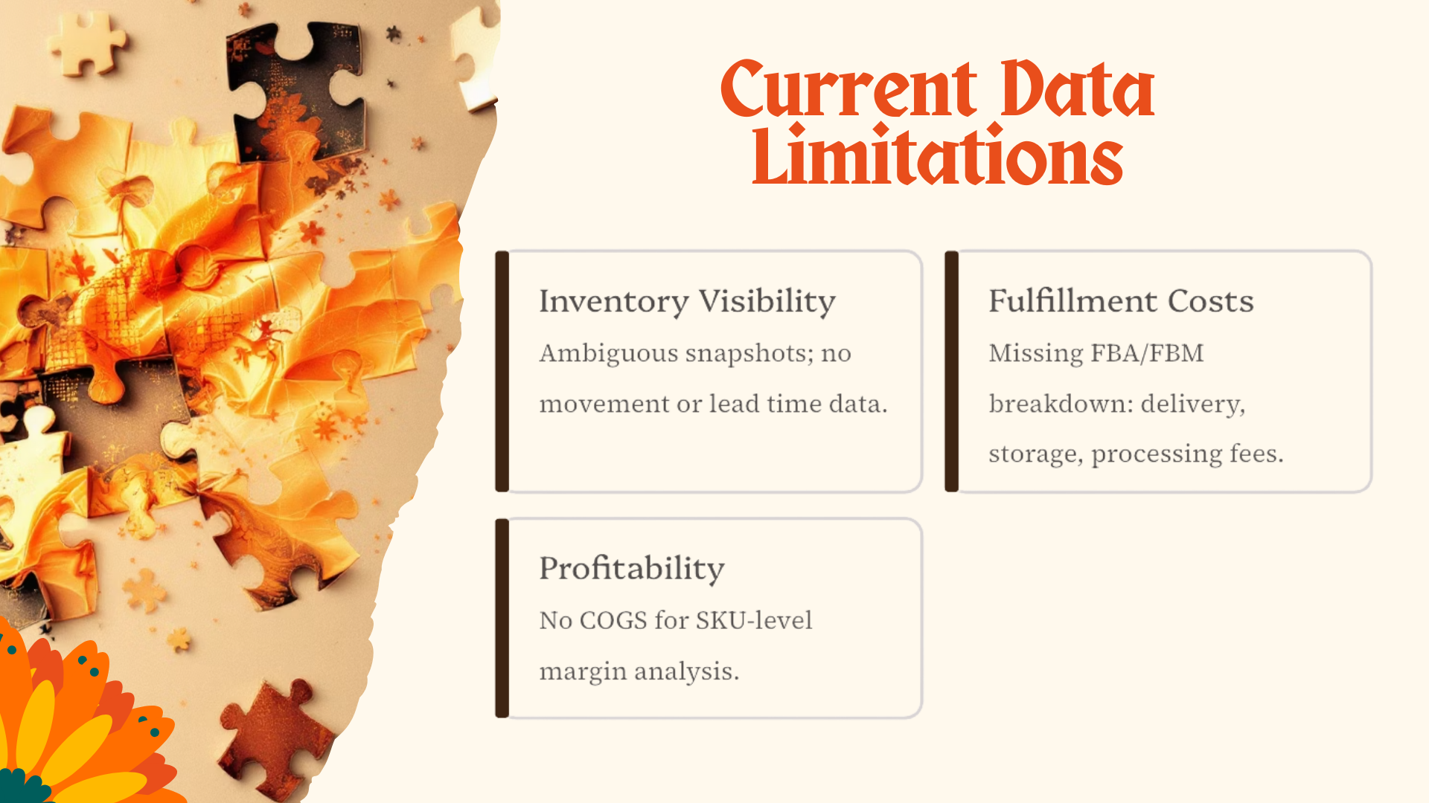

Current Data Limitations
Our analysis used Kaggle data, facing inherent constraints:
Inventory Visibility
Fulfillment Costs
Ambiguous snapshots; no movement or lead time data.
Missing FBA/FBM breakdown: delivery, storage, processing fees.
Profitability
No COGS for SKU-level margin analysis.
Notes:
⭐ 11. Limitations & Real-World Data Extensions (1 min)
“Our dataset had several limitations:
Inventory data was a single snapshot and capture the specific moment, so we couldn’t analyze true stock flow.
lead time, and turnover rate was abse
Fulfillment costs for FBA vs FBM were missing.
Product cost (COGS) was unavailable, which limited profitability analysis.

Slide 25


From Gaps to Action: Leveraging Real-World Data
Inventory Optimization
Lead-time and turnover-based strategies.
Inventory Optimization
Cost Efficiency
Lead-time and turnover-based strategies.
Fulfillment cost-effectiveness (FBA vs. 3PL).
Cost Efficiency
Profitability Analysis
Fulfillment cost-effectiveness (FBA vs. 3PL).
SKU-level margin-driven product mix.
Profitability Analysis
Real-time Prediction
SKU-level margin-driven product mix.
Stock-out/overstock forecasting for efficiency.
Our dashboard evolves into a robust BI tool with comprehensive operational data.
Real-time Prediction
Stock-out/overstock forecasting for efficiency.
Our dashboard evolves into a robust BI tool with comprehensive operational data.
Notes:
With this dashboard, we’re able to do several things.
First, for inventory optimization, we support lead-time and turnover–based strategies.
Second, in terms of cost efficiency, we can compare fulfillment cost-effectiveness, such as FBA versus third-party logistics.
Third, for profitability analysis, we analyze SKU-level margins to build a more efficient product mix.
Finally, through real-time prediction, we can forecast stock-out and overstock risks.
Overall, this dashboard evolves into a robust BI tool that supports real operational decision-making with comprehensive data.
This dashboard can evolve into a simple BI tool that supports market entry and inventory decisions.

